Slide 1

Capstone Project:
Final Presentation
Developing an ML model to predict which existing Paychex clients are most likely to purchase PEO
The A Team • 12.01.2021
DSC 383W / 483: Data Science Capstone • FALL2021ASE
Notes:
Introduce each team member individually

Slide 2
Overview
Project Sponsor:
Paychex, Inc.
Academic Advisor:
Prof. Ajay Anand
Team Members:
Ledion Lico
Jordan Pappas
Isaac Manly
Brian Winn
Expected Delivery Date:
December 13, 2021

Slide 3
Agenda
Vision / Goals
Dataset Description / EDA
Methods / Results
Challenges / Next steps

Slide 4
Goals: Business Understanding
Paychex would like to introduce PEO (Professional Employer Organization) to clients who are likely to be a good fit for the upsell service.
Introducing Paychex Clients to additional products can be a win-win:
Additional revenue for Paychex
Cost savings and service improvement for client
Objective:
Develop a model that predicts which existing Paychex Clients are most likely to purchase PEO (Basic or Master plan).

Slide 5
Goals: Vision
Project Vision:
Paychex wants to increase revenue for its business and reduce costs/improve service for its clients by selling more PEO products.
Project Goals:
Perform exploratory data analysis.
Create a supervised classification model for PEO upsells
(Non master or Master).
Propose plausible scenarios on how to deploy and scale the model.
Deliver a list of the most probable Paychex clients to buy PEO services.

Slide 6
Goals: Project Charter
Task | Target date | Actual Date | Status
Get Access to Data | 09/28/2021 | 09/28/2021 | Completed
Present Project Charter Document | 10/15/2021 | 10/13/2021 | Completed
Exploratory Data Analysis | 10/15/2021 | 10/13/2021 | Completed
Baseline Model Development | 10/25/2021 | 10/25/2021 | Completed
Additional Model Development and Model Comparison Framework | 11/20/2021 | 11/22/2021 | Completed
Final Presentation | 12/01/2021 | 12/01/2021 | Completed
Final Report and Code Delivery | 12/13/2021 |  | In Progress

Slide 7
Definitions
Recall = measurement of ability to find all relevant cases within dataset
Precision = measurement of ability to find all relevant cases within predicted set
F1-Score = harmonic mean between recall and precision
SMOTE = method to generate synthetic samples for the minority class
Optuna = method to automatically optimize model performance
K-Means = algorithm used to find groups not explicitly labeled in the data
XGBoost = algorithm built by a sequence of initially weak models into increasingly more powerful models

Slide 8
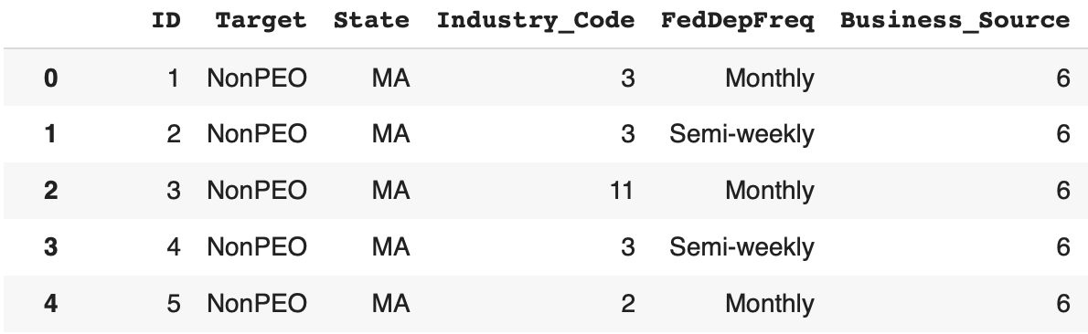
EDA: Dataset Description
40K+ sample clients, 1 record per client
1 target variable (3 labels) for PEO status
35 potential predictive variables across client attributes
No missing values
Target Variable
Predictive Variables

Slide 9
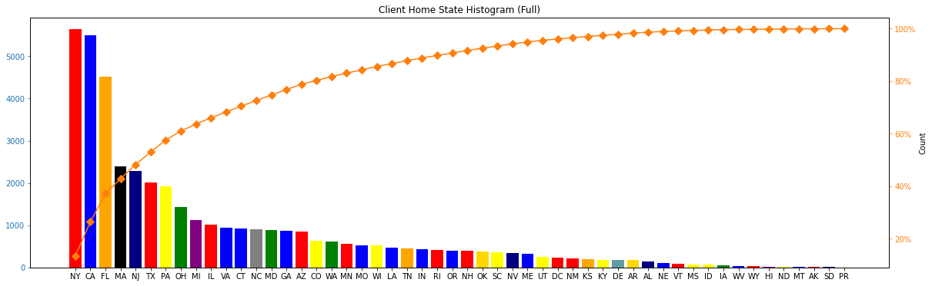
EDA: State Histogram
New York, California, and Florida have the highest counts.

Slide 10
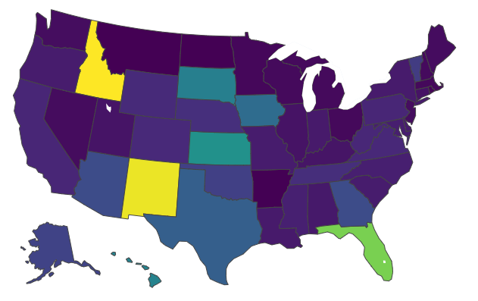

EDA: PEO over Total Clients by State
Highest PEO:Total Ratio
Idaho
New Mexico
Florida
Lowest PEO:Total Ratio
Montana
Arkansas
North Dakota

Slide 11
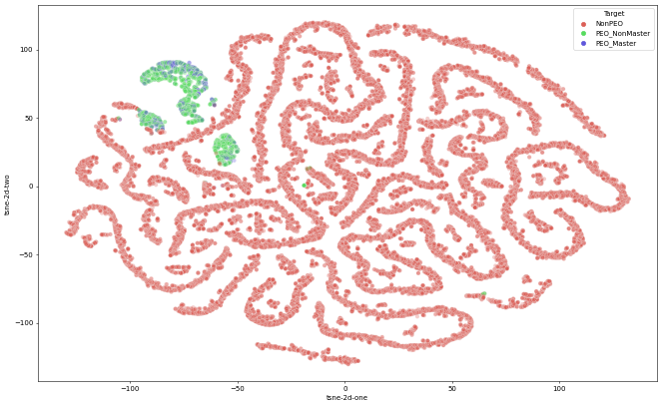
EDA: t-SNE Visualization
NonPEO vs PEO_Any are highly separable
PEO_NonMaster vs PEO_Master are not very separable
Notes:
As shown here, when the variables are compressed into two dimensions, we can distinguish NonPEO and PEO, but not necessarily PEO_Master and PEO_NonMaster

Slide 12
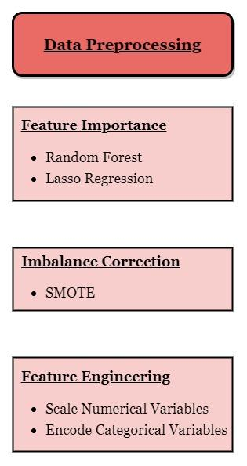
Methods: ML Pipeline Diagram
Notes:
Isaac

Slide 13
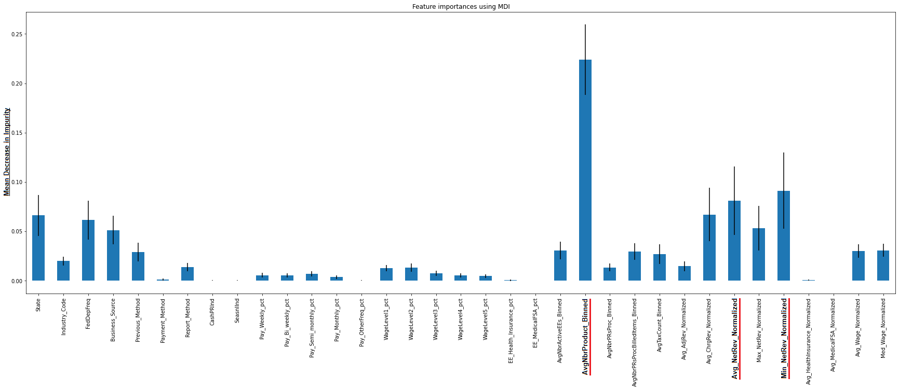
Feature Importance using Random Forest
Most important features:
Average Number Products Binned
Average Net Revenue Normalized
Min Net Revenue Normalized

Slide 14
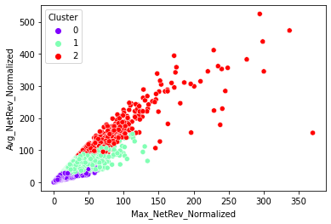
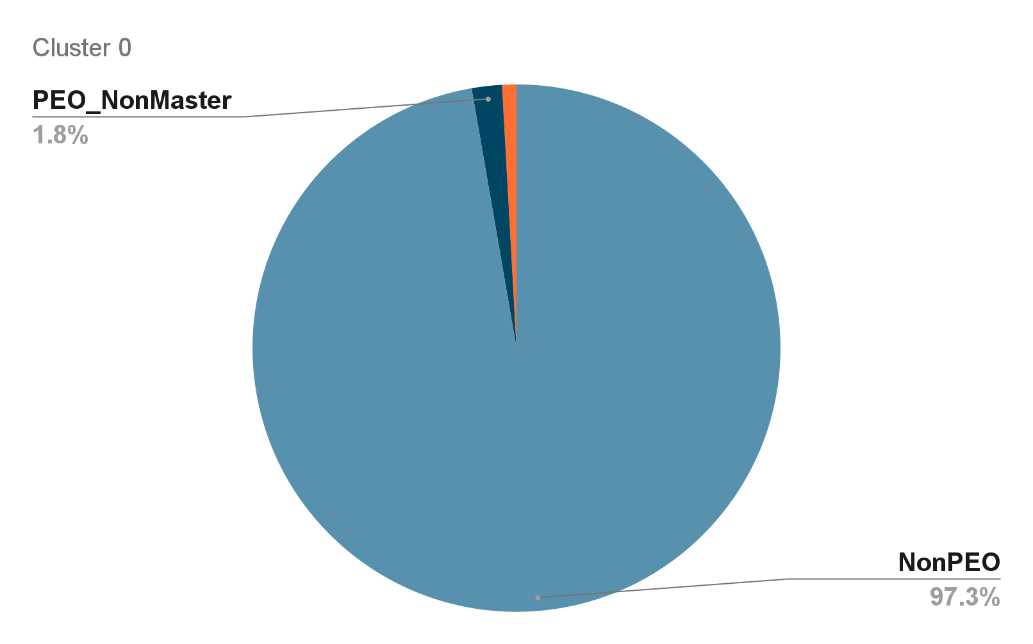
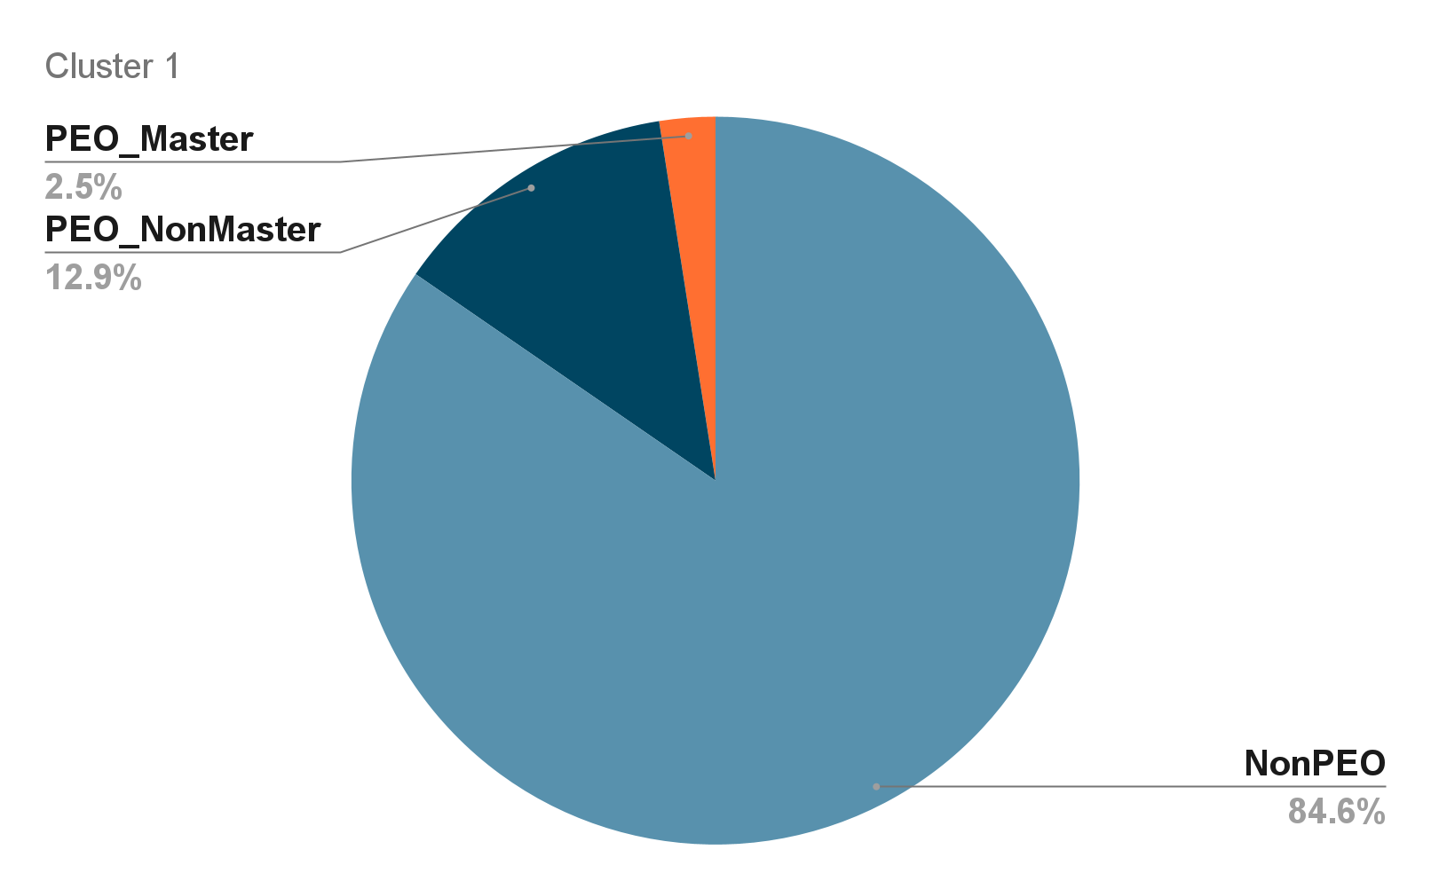
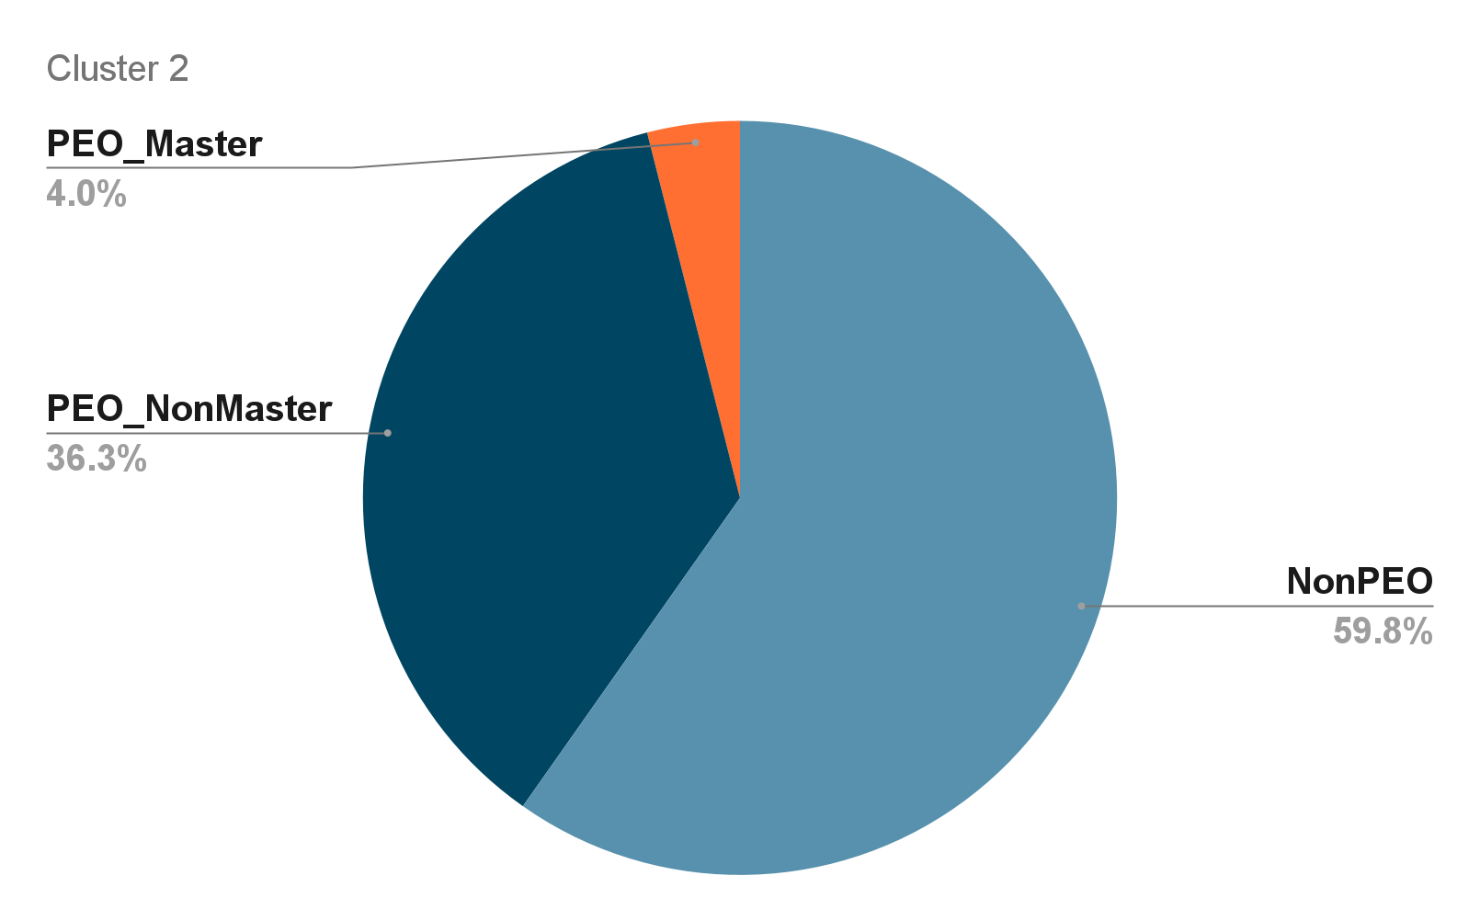
K-Means Clustering

Slide 15
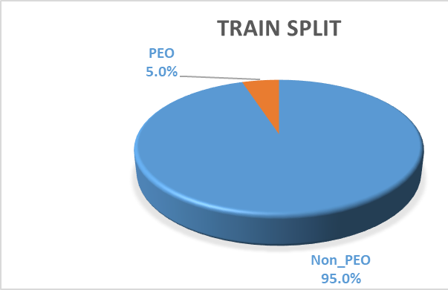
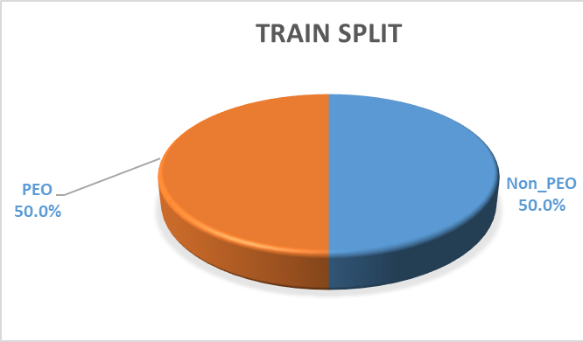
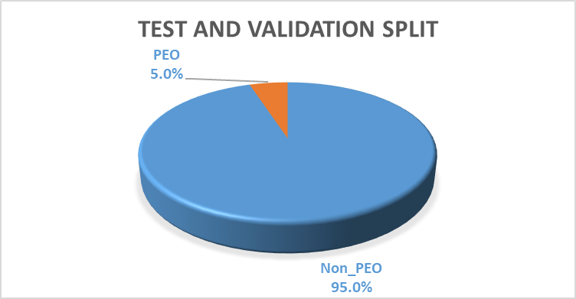
Binary Dataset Split
SMOTE
Set | Split
Train | 70%
Validation | 15%
Test | 15%
Notes:
Brian

Slide 16
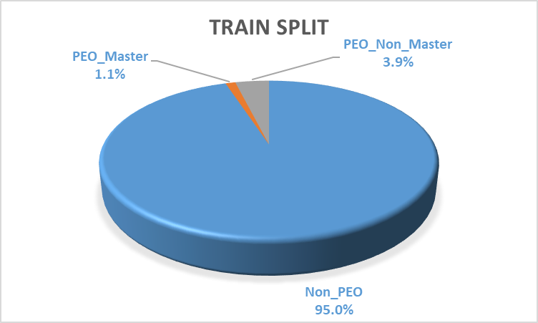
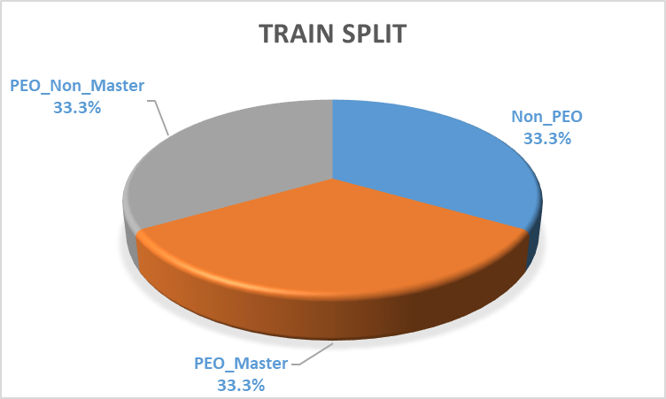
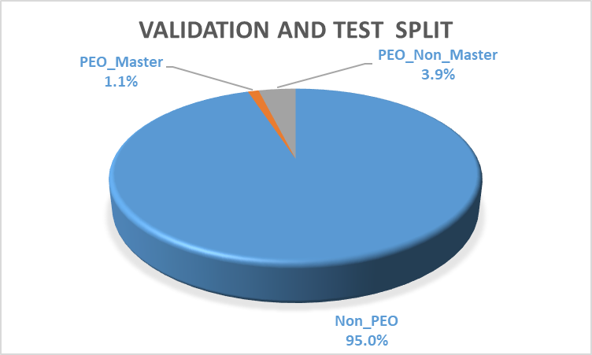
Multiclass Dataset Split
SMOTE
Set | Split
Train | 70%
Validation | 15%
Test | 15%
Notes:
Brian

Slide 17
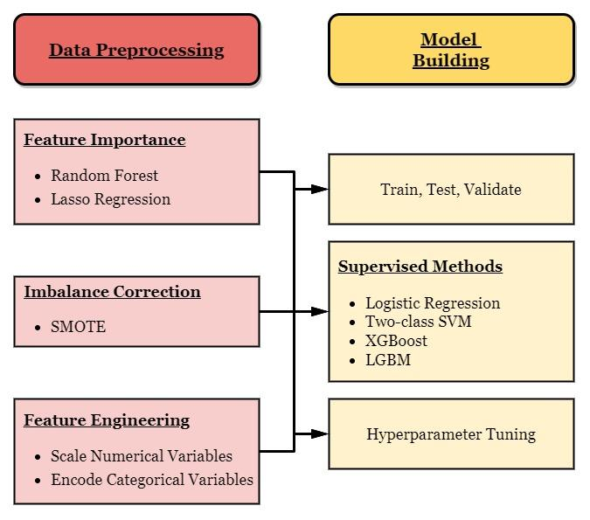
Methods: ML Pipeline Diagram
Notes:
Brian

Slide 18
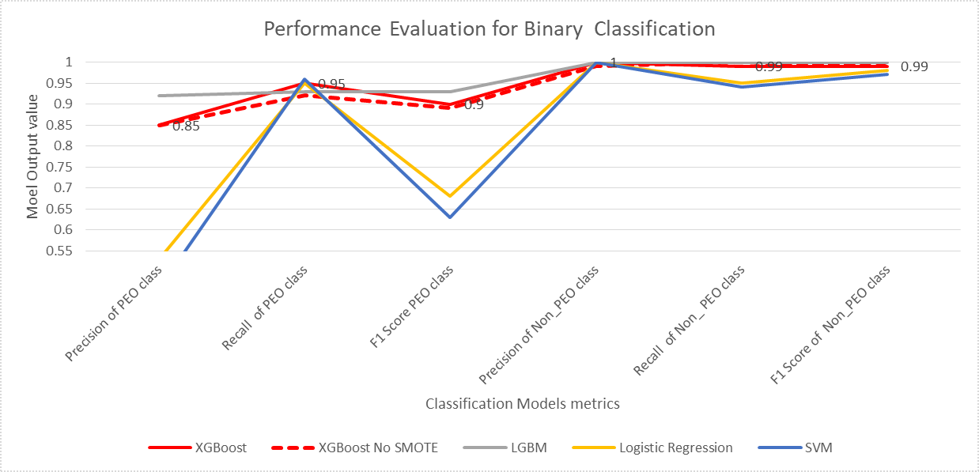
Results: Binary Models optimized with Optuna
Gradient Boosting Algorithms are the best performers
SMOTE has low impact in the binary case
Notes:
Brian

Slide 19
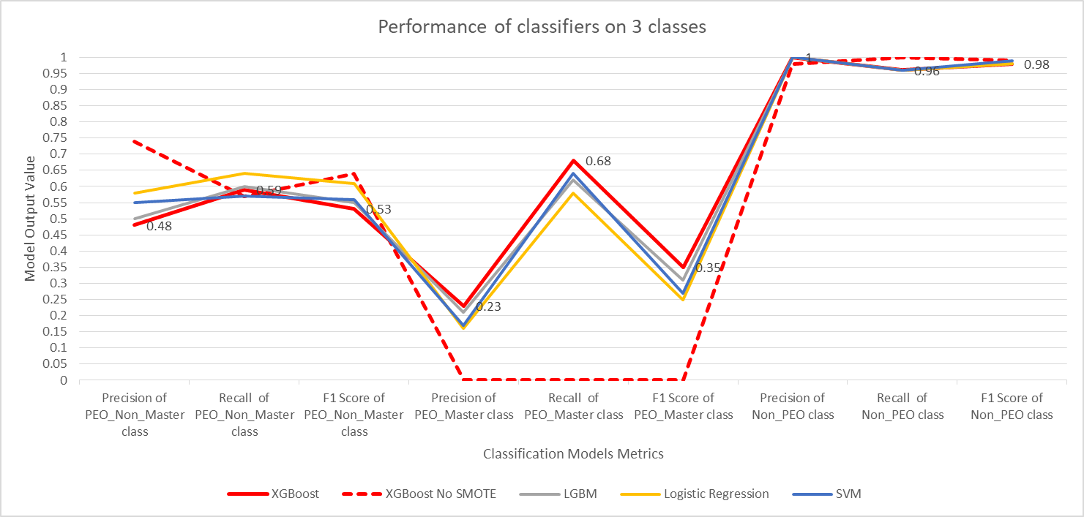
Results: Multiclass Models optimized with Optuna
XGBoost and LGBM: more flexible and slightly better recall in the minority classes
SMOTE has big impact in the minority classes
Notes:
Brian

Slide 20
Results: XGBoost (Grid Search)
 | Binary XGBoost |  | Multiclass XGBoost
Classes | Non PEO | PEO | Non PEO | PEO Non_Master | PEO_Master
Precision | 0.99 | 0.69 | 1 | 0.48 | 0.19
Recall | 0.98 | 0.89 | 0.96 | 0.62 | 0.60
F1 Score | 0.99 | 0.78 | 0.98 | 0.54 | 0.28

Slide 21
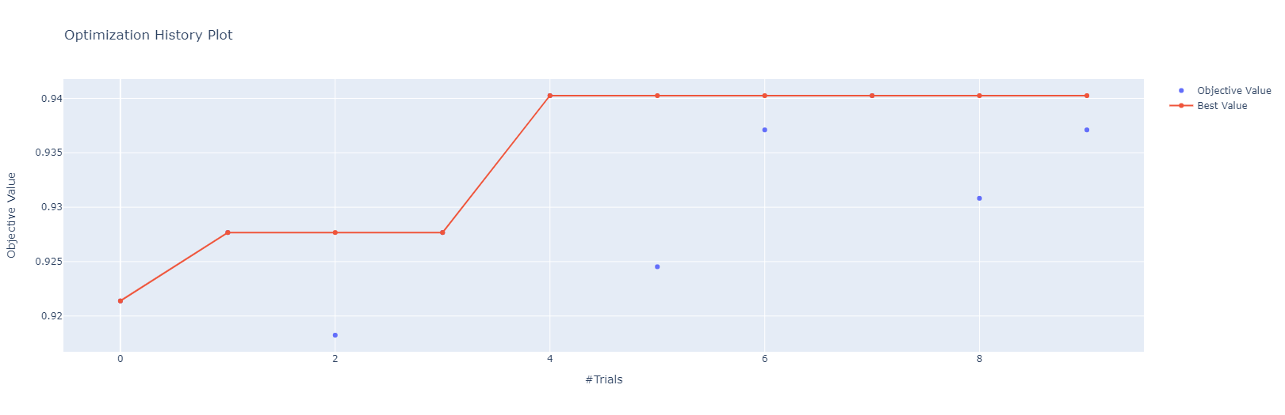
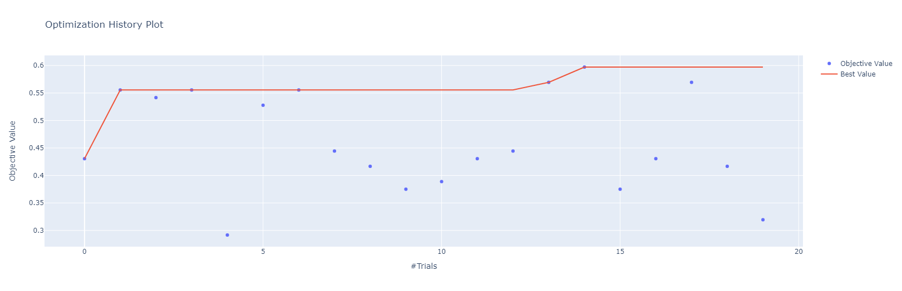
Results: XGBoost (Optuna)
Binary
Multiclass

Slide 22
Results: XGBoost (Optuna)
 | Binary XGBoost |  | Multiclass XGBoost
Classes | Non PEO | PEO | Non PEO | PEO Non_Master | PEO_Master
Precision | 1 (+.01) | 0.85 (+.16) | 1 | 0.48 | 0.23 (+.04)
Recall | 0.99 (+.01) | 0.95 (+.06) | 0.96 | 0.59 (-.03) | 0.68 (+.08)
F1 Score | 0.99 | 0.90 (+.12) | 0.98 | 0.53 (-.01) | 0.35 (+.07)
Optuna is more flexible and time efficient than Grid Search

Slide 23
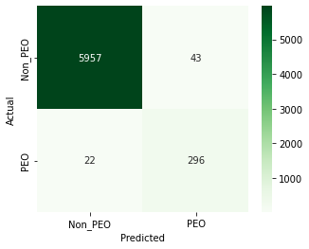
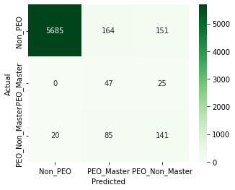
Results: XGBoost Validation
Binary Model
Multi-Class Model
Validation results are similar to test results

Slide 24

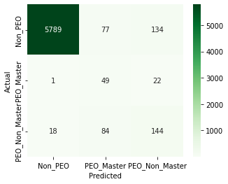
Results: XGBoost Test
Binary Model
Multiclass Model
The number of the PEO clients we misclassify as Non_PEO is similar across binary and multiclass
We have a “good” misclassification towards PEO Non_Master in multiclass

Slide 25
Results:
SMOTE helps overcome dataset imbalance
XGBoost and LGBM models outperform other models in binary classification
XGBoost outperform other models in multiclass classification
Optuna dramatically improves model performance, while being time efficient
In cases of larger datasets, LGBM is recommended, as less computation time is needed

Slide 26
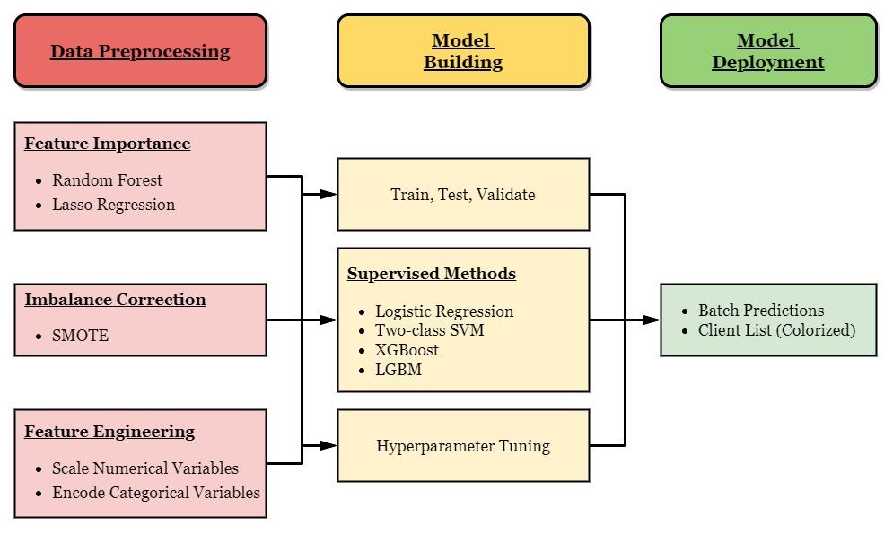
Methods: ML Pipeline Diagram
Notes:
Brian

Slide 27
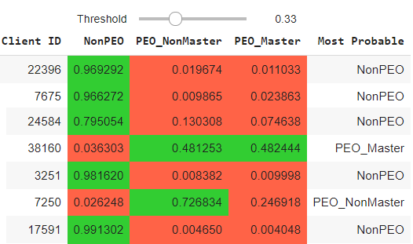
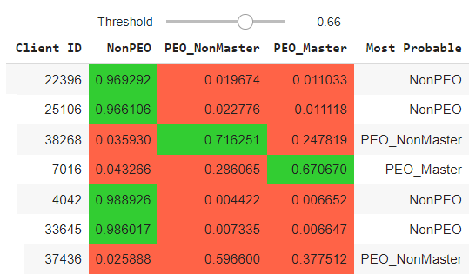
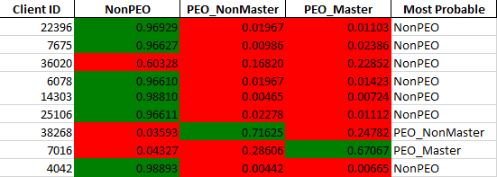
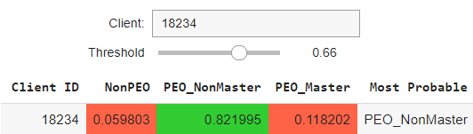
Deliverable: Client Lists
Client list is built in Google Colab
Has client lookup and adjustable threshold features
Can be exported to Excel (.xlsx)
Notes:
Brian

Slide 28
Achievements:
Identified interesting patterns and the most important Paychex client features
Built a reliable model to identify high-likelihood PEO clients
Optimized the model in multiclass classification to identify PEO_Master clients with improved recall
Provided the Paychex Sales team with the tools to predict high-likelihood clients, including an adjustable probability threshold

Slide 29
Challenges:
Immense data imbalance
Defining the optimal model architecture
Optimizing the recall on the PEO_Master class
Missing domain knowledge on Paychex sales process
Developing the best interface for the sales team

Slide 30
Future Work:
Alternate resampling methods
Further optimizing XGBoost and LGBM results
Anomaly detection for sequential model framework
Alternate prediction applications for sales team
Collect additional data from Paychex PEO clients

Slide 31
Acknowledgements:
Special thanks to the Paychex Data Science and Sales Teams
Special thanks to Professors Anand and Caliskan
Special thanks to Google Suite (Colab, Docs, and Slides)
Special thanks to Slack (Private Slack Channel)

Slide 32
Q&A

Slide 33
Thank You!
The A Team

